Slide 1
C29PE Economics for Professionals
Week 2 – The Working of Competitive Markets
Sloman et al., 2023, Chapters 4 & 5

Slide 2
Structure of the session
Demand and Supply
Price Determination and Output
Equilibrium in Markets
Markets where prices are controlled
Price Elasticity of Demand
The Relationship between Price Elasticity of Demand and Total Revenue
Income Elasticity of Demand, Cross-Price Elasticity of Demand and Price Elasticity of Supply

Slide 3
References
Sloman et al (2023)
  Chapter 4.3 – 4.4
  Boxes 4.1 & 4.2
  Chapter 5.1 – 5.3
  Boxes 5.1 & 5.2
Important!
  The PowerPoint slide deck for Week 2 lecture provides a guideline of the topics you need to know. However, the materials in the slide deck are insufficient if you wish to excel in the course
  To do well, please do not forget to read the relevant sections of the core textbook
  Please also ensure that you follow economics news regularly as these sources could be used as examples to supplement your answers during assessments

Slide 4
Thinking about markets
Assume that we can define a market from its context
  The market for street food in Edinburgh
  The market for air travel in Asia
  The global market for coffee beans
Two sides to every market for goods and services
  Supply: provided by firms which create the goods and services
  Demand: provided by individual consumers who buy them
    Market supply – the total amount which firms bring to the market
    Market demand – the total amount which consumers buy in the market

Slide 5
Business in a Competitive Market
  In a free market
    Consumers are free to decide what to buy with their incomes (i.e., free to make demand decisions)
    Firms are free to choose what to sell and what productions methods to use (i.e., free to make supply decisions)
    Consumers create the demand, and firms provide the supply and the two together create a market, where prices and quantities exchanged are established.
    This interaction of supply and demand to establish prices and quantities is known as the market mechanism.

Slide 6
Demand
  The Relationship between Demand and Price
    What would you do if the price of something you buy increases?
  The Law of Demand - when the price of a good rises, the quantity demanded will fall
      Income effect – people will feel poorer. They will not be able to afford to buy as much of the good with their money.
      Substitution effect – the price has risen relative to other goods. People will therefore switch to alternative or ‘substitute’ goods.
      *Quantity demanded refers to the amount consumers are willing and able to purchase at a given price over a given time period, not what people would like to consume.
  Activity – take two minutes to draw a demand curve

Slide 7
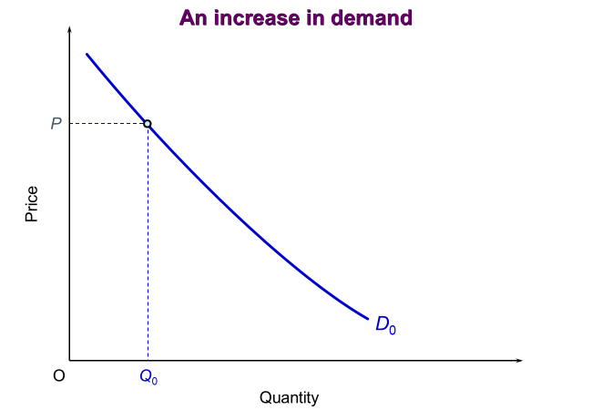

Demand
Demand curve for an individual – shows the different quantities of a good that a person is willing and able to buy at a given price over a given period
Market demand curve – shows the different total quantities of a good that consumers are willing and able to buy at various prices over a given time period.
As price falls, demand increases.
As price increases, demand falls.

Slide 8
Demand
    Activity – take a minute to write down (or discuss with a partner) what factors, other than price, determine how much of a specific good you (or other consumers) will buy.

Slide 9
Demand
Determinants of demand:
Price
Tastes (influenced by advertising, fashion, observing what others buy, health considerations, etc.)
Number and price of substitute goods
Number and price of complementary goods
Income
Distribution of income
Expectations of future price changes
Others …
Notes:
3

Slide 10
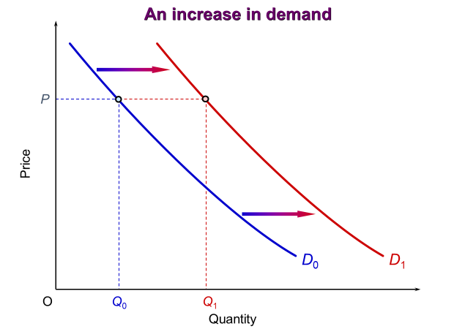
Demand
Example of Tesla (electric) cars
A rightwards shift to D₁ could be caused by:
An advertising campaign by Tesla
Changes in consumers’ attitudes towards environmental damage (a greater desire to help reduce climate change)
An increase in the price of petrol and/or diesel
A fall in the price of electricity
An increase in the number of charging points available across the country
An increase in people’s incomes
A redistribution of income from the poor to the rich
An expectation that the price of electric cars will increase soon, due to shortages of electric vehicles
  A change in price - movement along the demand curve (a change in the quantity demanded)
  A change in any other determinants of demand - shift in the demand curve (change in demand at every price).

Slide 11
Business in a Competitive Market
  The interdependence of goods and factor markets
  Effect of a rise in the demand for a good
    response in goods market
    response in factor markets
  Tesla example: what will happen in factor markets and other goods markets if the demand for Tesla vehicles increases?
    Tesla has 800+ suppliers
    Increase in demand for: minerals used in batteries (lithium, nickel and cobalt); factory sites; labour – engineers, designers, car assemblers, sales representatives, scientists, miners, those working in refining, etc.; tyres, aluminium, steel, carbon fibre, silicon, copper wire, etc.
2022-tesla-impact-report.pdf

Slide 12
Supply
Relationship between supply and price
  General relationship - as price rises, firms supply more
    it is worth incurring the extra unit costs
    firms switch from less profitable goods
    in the long run, new firms will be encouraged to enter the market
The supply curve
  A supply curve can be an individual firm’s supply curve or the market supply curve (i.e., that of the whole industry)
  Generally upward sloping (varies depending on the time period over which firms’ responses to price changes are considered)
  Activity – add a supply curve to your diagram
Notes:
4

Slide 13
Demand and Supply
Price
S
D
Quantity
Notes:
4

Slide 14
Supply
Determinants of supply
Price (movement along supply curve)
Costs of production (shift in supply curve)
  Costs of production will rise if wages, raw material prices, rents, interest rates or other input prices rise
  Technological advances can fundamentally alter the costs of production, for e.g., the microchip revolution has changed production methods and information handling in many industries
  Organisational changes: various cost savings can be made by reorganising production
  Costs are lowered by government subsidies and raised by taxes. Costs may also be affected by changes to laws or regulations.
Notes:
5

Slide 15
Supply
  Profitability of alternative products (shift in supply curve)
    Movement of resources from the production of one good to another as circumstances change.
    For e.g., in 2020 several drink producers switched to producing hand sanitiser.
  Profitability of goods in joint supply (shift in supply curve)
    Sometimes when one good is produced, another good is also produced at the same time.
    For e.g., the refining of crude oil to produce petrol. If more petrol is produced, the production of other grade fuels, such as diesel and paraffin, increases too.
Notes:
5

Slide 16
Supply
  Nature and other random shocks (shift in supply curve)
    For e.g., the weather and diseases affecting farm output, wars affecting the supply of imported raw materials, industrial disputes, earthquakes, floods and pandemics, such as Covid-19.
  Aims of producers (shift in supply curve)
    A profit-maximising firm will supply a different quantity to a firm that is trying to maximise sales
  Expectations of producers (shift in supply curve)
    If price is expected to rise, producers may build up their stocks and release them on to the market once the price has risen. They may also plan to produce more, by installing new machines or taking on more labour, in advance of the price rise.
  The number of suppliers (shift in supply curve)
    If new firms enter the market, supply is likely to increase
Notes:
5

Slide 17
Price and Output Determination
We can now combine our analysis of demand and supply.
  We can show how the actual price of a product and the actual quantity bought and sold are determined (in a free and competitive market)
  The price, where demand equals supply, is called the equilibrium price or market clearing price.
  The equilibrium price is the only price at which producers’ and consumers’ wishes are mutually reconciled: where the producers’ plans to supply exactly match the consumers’ plans to buy.
  The effect of price being above equilibrium
    surplus → price falls
  The effect of price being below equilibrium
    shortage → price rises
Notes:
7

Slide 18
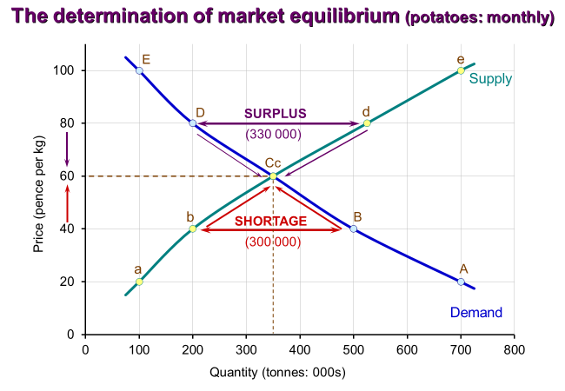
Price and Output Determination
Notes:
7

Slide 19
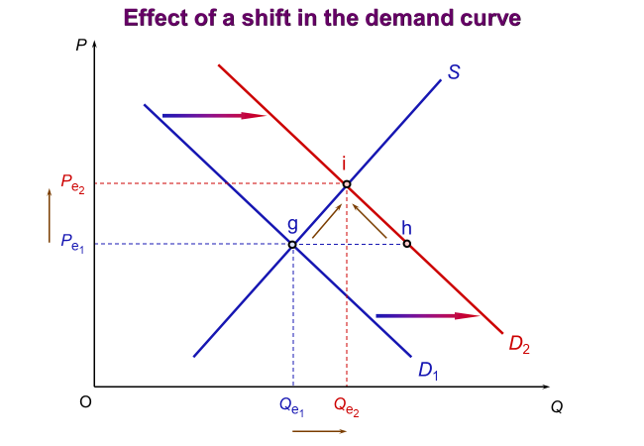
Price and Output Determination
Movement to a new equilibrium
  The equilibrium price will remain unchanged if the demand and supply curves remained unchanged.
  If one of the determinants of demand changes (other than price), the whole demand curve will shift.
  For e.g., if an increase in consumers incomes lead to the demand curve shifting to D₂, there will be a shortage at the original price.
  This will cause the price to rise to the new equilibrium price and lead to a movement along the supply curve to the new intersection point.
Notes:
7

Slide 20
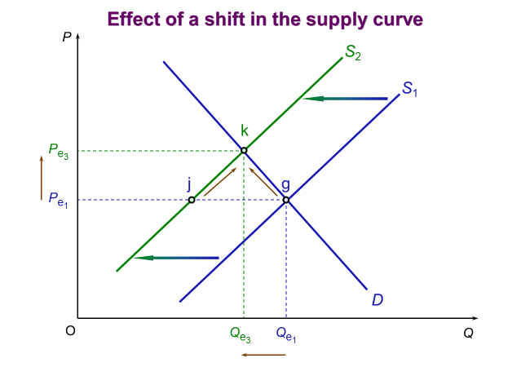
Price and Output Determination
Movement to a new equilibrium
  If one of the determinants of supply (other than price) changes, the whole supply curve will shift.
  This will lead to a movement along the demand curve to the new intersection point.
  For e.g., if the costs of production rose, the supply would shift to the left (to S₂)
  There would be a shortage at the old price.
  Price would rise from P_{e1} to P_{e3} and quantity would fall from Q_{e1} to Q_{e3}
  Sometimes several determinants might change, leading to a shift in both curves.
Notes:
7

Slide 21
Price and Output Determination
Activity: add to your diagram, a fall (leftwards shift) in demand (due to a fall in price of a substitute good) and an increase (rightwards shift) in supply (due to technological advancements in production)
What happens to price, and quantity demanded?
Notes:
7

Slide 22
Price and Output Determination
If there is a leftward shift in demand and a rightwards shift in supply, price will fall from P1 to P2
Quantity will increase from Q1 to Q2
If the shift in demand and the shift in supply are the same size, there will be no change in Q
We do not know if the fall in demand is bigger or smaller than the increase in supply**
Price
S₁
S₂
P₁
P₂
D₁
D₂
Q₁
Q₂
Quantity
Notes:
7

Slide 23
Demand and Supply
Activity – check your understanding by attempting the following multiple-choice question:
What is the likely outcome of disruptions to shipping routes in the Red Sea on the supply of oil? Hint – it makes it slower and more difficult to get oil to different locations, effectively reducing supply.
  (A) A leftward shift in the supply curve and a fall in the equilibrium price of oil
  (B) A rightward shift in the supply curve and a fall in the equilibrium price of oil
  (C) A leftward shift in the supply curve and an increase in the equilibrium price of oil
  (D) A movement down the supply curve and an increase in price
Notes:
5

Slide 24

Demand and Supply
Activity – check your understanding by attempting the following multiple-choice question:
What is the likely outcome, if a product (such as the Stanley Quencher tumbler), is promoted by a group of popular social influencers?
  (A) A rightward shift in the demand curve and a fall in the equilibrium price
  (B) A rightward shift in the demand curve and an increase in the equilibrium price
  (C) A leftwards shift in the supply curve and an increase in the equilibrium price
  (D) A movement up the demand curve and an increase in price
https://uk.stanley1913.com/products/adventure-quencher-h2-0-flowstate-tumbler-40-oz
  Read more about this example: https://www.retaildive.com/news/stanley-quencher-tumblers-viral-success/699416/
Notes:
5

Slide 25
The Working of
Competitive Markets
Markets where Prices are Controlled

Slide 26
Markets where Prices are Controlled
Over the years – general shift in economies across the world to a more market-based system that allows the market to work.
Leads to an efficient market
However, is there an argument against the price mechanism and in favour of government intervention to fix prices?
The equilibrium price is not necessarily the ‘best’ price.
Minimum price (price floor) - when a price is set above the equilibrium
Maximum price (price ceiling) - when a price is set below the equilibrium
Notes:
26
7

Slide 27
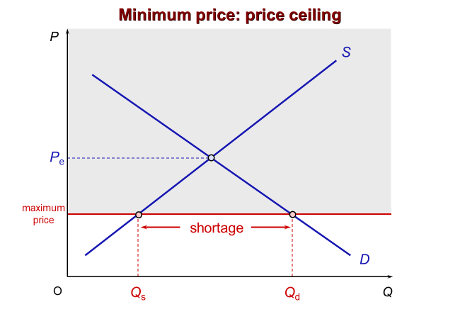
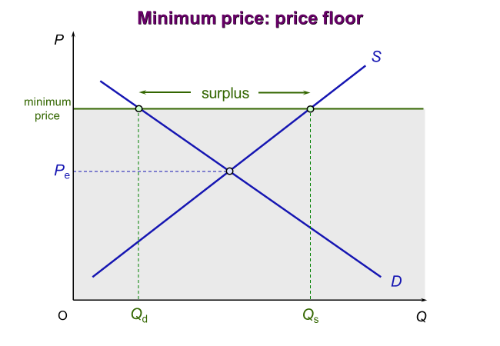
Markets where prices are controlled
Maximum
Rent caps
Food price caps during periods of war/rationing
Tickets for some football matches or concerts
Minimum price for alcohol (UK)
Minimum wage
The EU has used minimum prices for agriculture
Notes:
27
7

Slide 28
Business in a Market Environment
Price Elasticity of Demand

Slide 29
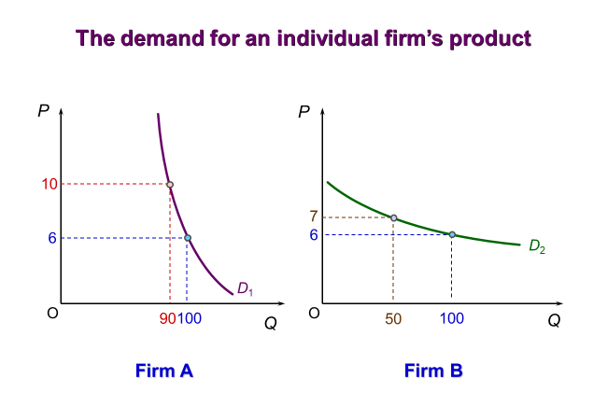
Price Elasticity of Demand
Activity - discuss with the person next to you:
When you drew your demand curve earlier in the lecture, did you draw it like Firm A’s demand curve or more like Firm B’s demand curve?
Both the demand curve of Firm A and the demand curve of Firm B meet the law of demand, but what is the difference between them?
What kind of firm/product might have a demand curve like Firm A?
What kind of firm/product might have a demand curve like Firm B?

Slide 30







Price Elasticity of Demand
Luxury v Necessity
Short or Long Run
Proportion of Income
Habit forming?
Closeness of substitutes
Notes:
Luxury/necessity (diamonds elastic/ salt inelastic)
Closeness of substitutes (ferries/buses) – the closer the substitute the more elastic
Proportion of income (matches/houses) high % of income = elastic, low % of income inelastic
Short or Long Run – short run more inelastic, long run more elastic
Habit forming goods like cigarettes are inelastic
Examples of perfectly price elastic demand (banknote)
perfectly price inelastic (life saving drugs/operation)

Slide 31
Price Elasticity of Demand
Elasticity - Responsiveness of one variable to a change in another
Price elasticity of demand (Pe_{D}) - Responsiveness of demand to a change in price
  Firms want to know how much demand will fall if they increase the price of their product or how much demand will increase if they reduce the price of their product.
  Why?
    Total sales revenue (TR) = price (P) x quantity sold (Q)
    If TR increases (and there are no changes in total costs), profit increases.
    If Q is very responsive to any changes in price, it’s better for the firm to reduce the price (we will be more specific shortly)
    If Q is not very responsive to any changes in price, better for the firm to increase the price

Slide 32
Price Elasticity of Demand
Measuring price elasticity of demand: %ΔQ_{D} / %ΔP
Activity: what is the price elasticity of demand if the quantity demanded increases from 8,000 units to 10,000 units when price is reduced from £80.00 to £72.00? Is demand elastic or inelastic?
    % change in price = (72-80)/80 = -1/10
    % change in qd = (10000 – 8000)/8000 = ¼
    Elsaticity = ¼ / -0.1 = - ?

Slide 33
Price Elasticity of Demand
%ΔQ_{D} = [(10,000 – 8,000)/8,000] x 100 = 25% %ΔP = [(80.00 – 72.00)/80.00] x 100 = -10%
Price elasticity of demand: %ΔQ_{D} / %ΔP = 25% / -10% = -2.5
The sign: positive or negative?
  We already know that demand curves are downward sloping.
  If prices increase, the quantity demanded will fall. If prices fall, the quantity demanded will rise.
  Price elasticity of demand will be negative.
The value (ignoring the negative sign): greater or less than 1?
  Elastic demand: ε > 1 where a change in P causes a proportionately larger change in Q (flatter curve).
  Inelastic demand: ε < 1 where a change in P causes a proportionately smaller change in Q (steeper).
  Unit elastic demand: ε = 1 where Q changes proportionately the same as P.

Slide 34
Business in a Market Environment
The Importance of Price Elasticity of Demand to Busines Decision Making

Slide 35
Price Elasticity of Demand & Business Decision Making
Price elasticity of demand and a firm’s sales revenue
Total sales revenue is equal to price times quantity sold (TR = P x Q)
Activity:
  If you were the owner of a business and you knew the price elasticity of demand for your product was elastic over a particular price range, would you increase or reduce its price?
  If you were the owner of a business and you knew the price elasticity of demand for your product was inelastic over a particular price range, would you increase or reduce its price?

Slide 36
Price Elasticity of Demand & Business Decision Making
    Elastic demand
    Quantity changes proportionately more than price – the change in quantity has a bigger effect on total revenue than does the change in price
    P rises; Q falls proportionately more; therefore, TR falls
    P falls; Q rises proportionately more; therefore, TR rises
    Inelastic demand
    Price changes proportionately more than quantity – the change in price has a bigger effect on total revenue than does the change in quantity
    P rises; Q falls proportionately less; TR rises
    P falls; Q rises proportionately less; TR falls

Slide 37
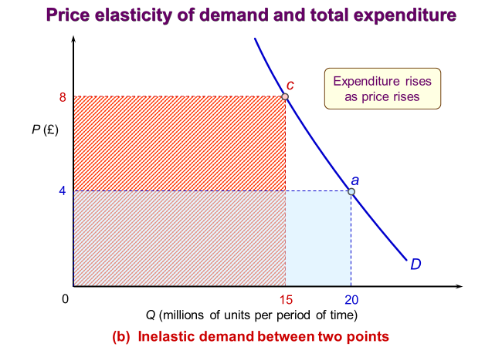
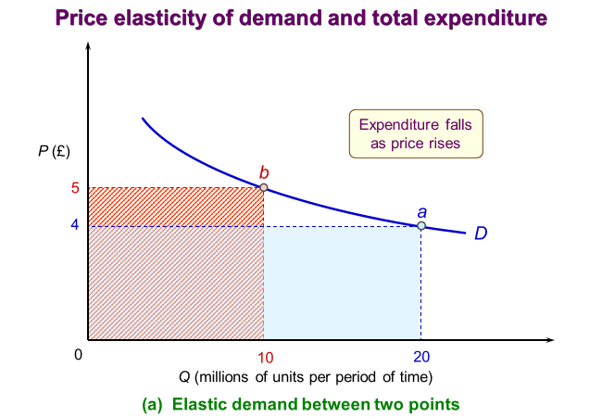
Price Elasticity of Demand & Business Decision Making
(b) Inelastic demand between two points
TR before price rise = £4.00 x 20,000 units = £80,000
TR after price rise = £8.00 x 15,000 units = £120,000
(a) Elastic demand between two points
TR before price rise = £4.00 x 20,000 units = £80,000
TR after price rise = £5.00 x 10,000 units = £50,000

Slide 38
The Working of
Competitive Markets
Other Elasticities

Slide 39
Other Elasticities – Income Elasticity of Demand
Income elasticity of demand (%ΔQ_{D} / %ΔY) - a measure of the responsiveness of demand to a change in consumer incomes
Degree of ‘necessity’ of the good
  In a developed country, the demand for luxury goods expands rapidly as people’s incomes rise, whereas the demand for basic goods, such as bread, rises only a little.
Level of income of consumers
  Sales of products with a high-income elasticity of demand are likely to expand rapidly as national income rises but may also fall significantly if the economy moves into recession.
  Demand for inferior goods decrease as income rises, as people switch to better-quality goods.
Notes:
11

Slide 40
Other Elasticities – Cross-Price Elasticity of Demand
Cross-price elasticity of demand (%ΔQ_{Da} / %ΔP_{b}) - a measure of the responsiveness of demand for one product to a change in the price of another (either a substitute or a complement).
If good ‘b’ is a substitute for good ‘a’, a’s demand will rise as b’s price rises, for e.g., Coca-Cola and Pepsi. In this case cross-price elasticity of demand will be a positive figure.
If ‘b’ is complementary to ‘a’, a’s demand will fall as b’s price rises and thus the quantity of ‘b’ demanded falls. For e.g., the demand for petrol falls as the price of petrol fuelled cars increases. In this case, the cross-elasticity will be negative.
Determinants - closeness of complements or substitutes – the closer the complement or substitute the bigger will be the effect on the first good of a change in price of the second good.
Notes:
11

Slide 41
Other Elasticities – Price Elasticity of Supply
Price elasticity of supply (%ΔQ_{S} / %ΔP) - the responsiveness of quantity supplied to a change in price.
Determinants of price elasticity of supply
  Amount that costs rise as output increases – the less the additional costs of producing additional output, the more firms will be encouraged to produce for a given price rise: the more elastic supply will be.
  Degree of spare capacity - supply is likely to be more elastic if firms have plenty of spare capacity, can readily get extra supplies of raw materials, can easily switch away from producing alternative products.
  Time period
    Immediate – firms are unlikely to be able to increase supply by much immediately, supply is virtually fixed
    Short run – some inputs can be increased (e.g., raw materials), while others will remain fixed (e.g., heavy machinery)
    Long run – there will be sufficient time for all inputs to be increased and for new firms to enter the industry.
Notes:
11

Slide 42
The Time Dimension of Market Adjustment
The full adjustment of price, demand and supply to a situation of disequilibrium will not be instantaneous.
Both producers and consumers take time to respond to a change in price.
It is helpful to analyse the time path that supply takes in responding to changes in demand.
The longer the time period, the bigger the response and thus the greater the elasticity of supply and demand.
Activity: think about (discuss with a partner), how producers (supply) will respond to a significant increase (rightwards shift) in demand, in different time periods.
Notes:
11

Slide 43
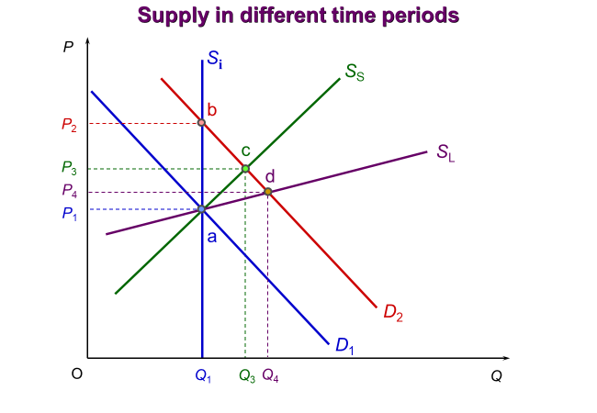
Other Elasticities – Price Elasticity of Supply
  S_{i} = immediate
  S_{S} = short run
  S_{L} = long run
Notes:
11

Slide 44
Summary
    Consumers create the demand, and firms provide the supply and the two together create a market, where prices and quantities exchanged are established.
    This interaction of supply and demand to establish prices and quantities is known as the market mechanism.
    The Law of Demand - when the price of a good rises, the quantity demanded will fall (due to the income and substitution effects).
    Demand is determined by price, tastes, number and price of substitute goods, number and price of complementary goods, income, distribution of income, expectations of future price changes, etc.
    The general relationship between supply and price is that as price rises, firms supply more
    Supply is determined by price, costs of production, profitability of alternative products, profitability of goods in joint supply, nature and random shocks, aims of producers, the number of suppliers, etc.
Notes:
11

Slide 45
Additional materials (for reading)

Slide 46
The Working of
Competitive Markets
Applications of the Market

Slide 47
Applications of the Market
Case study: The UK Housing Market
The Ups and Downs of the Housing Market
  Not only are actual prices rising over the long-term, but more significantly, prices are increasing in real terms too (this means that house prices are increasing relative to general prices).
  The average UK house price in January 1970 was a little over £3900. By January 2022, it had risen to over £274,000, an increase of nearly 7000 per cent.
The Determinants of House Prices
  House prices are determined by demand and supply.
  If demand rises (i.e., shifts to the right) or if supply falls (i.e., shifts to the left), the equilibrium price of houses will rise.
  If demand falls or supply rises, the equilibrium price will fall.
    Why did UK house prices rise so rapidly in the 1980s, from 1997-2007, from 2013-16 and from late 2020?
Notes:
47
7

Slide 48
Applications of the Market
Case study: The UK Housing Market
What caused these observed rises/falls in house prices? The answer lies primarily in the demand for housing.
  Incomes – the late 1980s, 1996-2007 and 2013-16 were periods of rising incomes or economic recovery and people were prepared to stretch themselves.
  Number of households – the desire for home ownership has increased over the years; there have been social and demographic changes, such as rising life expectancy and more single-parent families.
  Cost and availability of mortgages – as interest rates rise, the cost of mortgages increases. The confidence and ability of banks to lend changes depending on the state of the economy.
  Speculation – for e.g., if prices are increasing - people buy as soon as possible before prices increase, but sellers avoid selling until prices have increased even more.
  Supply-side factors – speculation about changing prices (short term), house building (long term).
Notes:
48
7

Slide 49
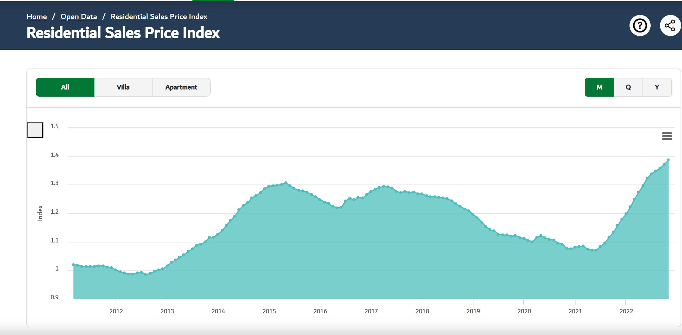
Applications of the Market
Case Study: The Dubai Housing Market
Activity – think about what might explain the changes in residential property in Dubai over the last ten years?
Dubai Land Department - Residential Sales Price Index
Notes:
49
7

Slide 50
Applications of the Market
Strong demand from residents, investors and high-net-worth individuals
Positive market sentiment
Dubai: Here's why property prices will continue to rise in 2024 - News | Khaleej Times.
Investor and buyer confidence
Dubai Property Market Surges: A Remarkable 18% Increase in Q3 2023 (dxbinteract.com)
Supply shortage in some segments
The market has been attracting high-net-worth individuals from around the world on the back of the UAE's strong economic rebound from the global pandemic-induced slowdown.
Dubai property prices: where they are rising and falling — May 2022 (thenationalnews.com)
Case study: the Dubai housing market.
Dubai Land Department - Residential Sales Price Index
Notes:
50
7

